Slide 1


Bioscience Awareness:
Bioscience Industrial Fellowship
Project (BIFP)
Jude Okoyeh (Forsyth Technical Community College) Bioscience Industrial Fellow, June 2014

Slide 2
Objectives
Bioscience and its disciplines.
Bioscience/Biotechnology Awareness – to diverse professionals
Biotechnology Career Paths
Required skills
Biotech Resources Facts: Nationwide; State of NC
Sustaining the Biotech work force: looking ahead
Experiences in BIFP program.
Industry/Institutions visited

Slide 3
Bioscience and its disciplines
Bioscience results in creating products that cure diseases, ensure that we have safe and abundant food and water, and contribute to creating new fuels.
Zoology
Botany
Biodiversity
Biophysics
Animal Biotechnology
Food Science
Biomedical Engineering
Ecology
Cell Biology
Genetics
Biochemistry
Forensic Science
Microbiology
Immunology
Molecular Biology
Bioethics

Slide 4
Skills required for Biotechnicians
Analytical skills: able to conduct scientific experiments and analyses with accuracy and precision.
Communication skills: They also need to be able to clearly communicate their processes and findings in written reports.
Critical-thinking skills: draw conclusions from experimental results through sound reasoning and judgment.
Observational skills: constantly monitor their experiments; keep a complete, accurate record of their work, and the results they obtained.
Technical skills: set up and operate sophisticated equipment and instruments. Adjust equipment to ensure that experiments are conducted properly.
Soft skills: Strong work ethic, positive attitude, time management abilities, problem-solving skills, a team player, self-confidence, flexibility/adaptability, etc.

Slide 5
Biotech Facts – US Department of Labor
Job Profile: Work with biological and medical scientists; conduct laboratory tests and experiments.
Work Environment: Biological technicians typically work in laboratories.
How to Become a Biological Technician: Need strong background in Sciences – biology, chemistry, math, physics, etc. or a closely related field.
Gain laboratory experience while in school through internships.
Pay: The median annual wage nationwide for biological technicians was $39,750 in May 2012 and varies by state.

Slide 6
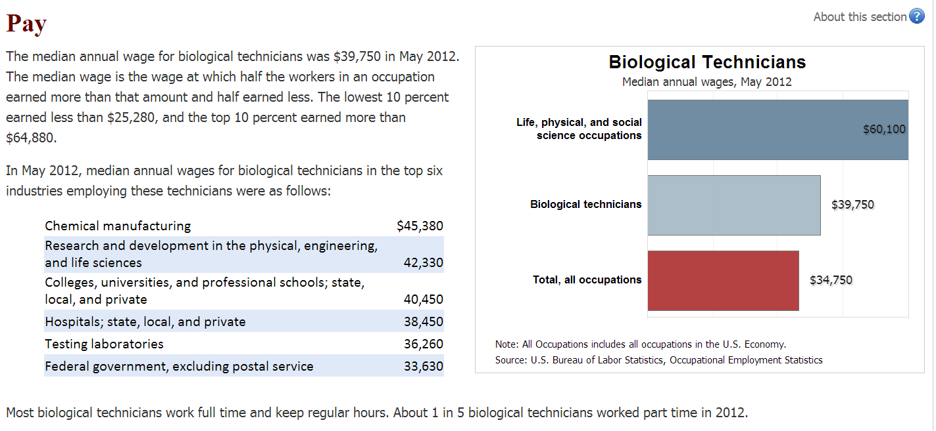
Biotech Facts – US Department of Labor

Slide 7
Biotech Facts – North Carolina
Biotech Industries generate ~$59 billion per year in economic activities statewide
Employs more than 58,000 residents; 50% are Biotechnicians
Employment is projected to grow 10 percent from 2012 to 2022, about as fast as the average for all occupations. Continued growth in biotechnology and medical research is expected to increase demand for these workers.
Drug development process involves high investment in R & D, clinical trials, etc. It involves safety, efficacy, quality and value.

Slide 8
Biotech Facts – North Carolina
Average entry level salary is $55,000 (BS degree) – Biogen idec
B.R.I.T.E. Graduation and Placement rate: 90%
Current average annual Biotech graduates: Forsyth Tech Community College, Rowan-Cabarrus Community College, and Alamance Community College is 18-20 students. NC state university: 163 students (BS), 21 (MS) 4 (PhD), 118 graduates between 2008-2013.
There is a growing need for trained Biotechnologists & Biotechnicians
Biotech awareness is not common in High School (Tengion - School survey).
Proposal: consistent biotech awareness at different school levels to generate interest among students’ early in their career decision phase.

Slide 9
Career Path for Biotech
Middle/High Schools
Colleges/Universities/
Workforce certification
Industries/ Academics
Research and Development | Manufacturing and Production | Quality Control and Assurance | Clinical Research | Sales and Technical support
Lab Technician, Research Assistant, Bioinformatics Analyst, Research Scientist, Forensic Scientist, Engineer | Environmental Technician, Manufacturing technician, Maintenance and Instrumentation Technician, Product Development Engineer, Process Technician | Quality Control Technician, Documentation Coordinator, Quality Control Analyst, Validation Specialist | Documentation Associate, Clinical Research Associate, Biostatistician, Regulatory Affairs Associate | Sales Associate, Facilities technician, Corporate Scientific Professionals

Slide 10
Current Biotech Resources
Academics – Universities, Community Colleges, Schools that
offer distance learning, short courses and degree programs
Research Institutes
Industries – pharmaceutical, medical, food/agricultural or
chemical manufacturers Government agencies
Other biotech affiliates - Triad Growth Partners (TGP) in NC

Slide 11
Proposed Mobilization Efforts
Middle and High Schools
Biotechnology introductory class visits
Bi-monthly Biotechnology Lab and Equipment Demonstration sessions
Outreach / Summer Programs
Survey/assessment
Colleges/Universities
Consistent Seminars/Workshops/Conferences
Comprehensive and Sustainable Partnerships with Biotech Institutes:
- Bioscience Awareness Centers
Partnerships with the Media

Slide 12
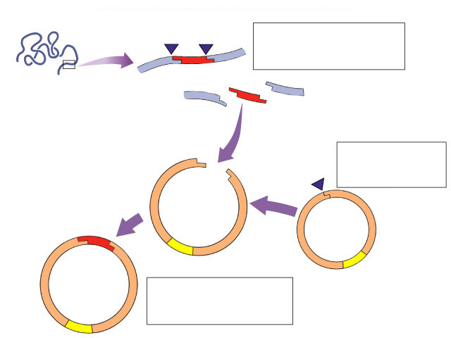
Biotechnology made easy using learning modules
Plasmids used to insert new genes into bacteria
cut DNA
gene we want
Use restriction enzymes
like what?
…insulin
…HGH
…lactase
cut plasmid DNA

Cut DNA?
DNA scissors?
ligase
insert “gene we want” into plasmid...
“glue” together
recombinant plasmid

Slide 13
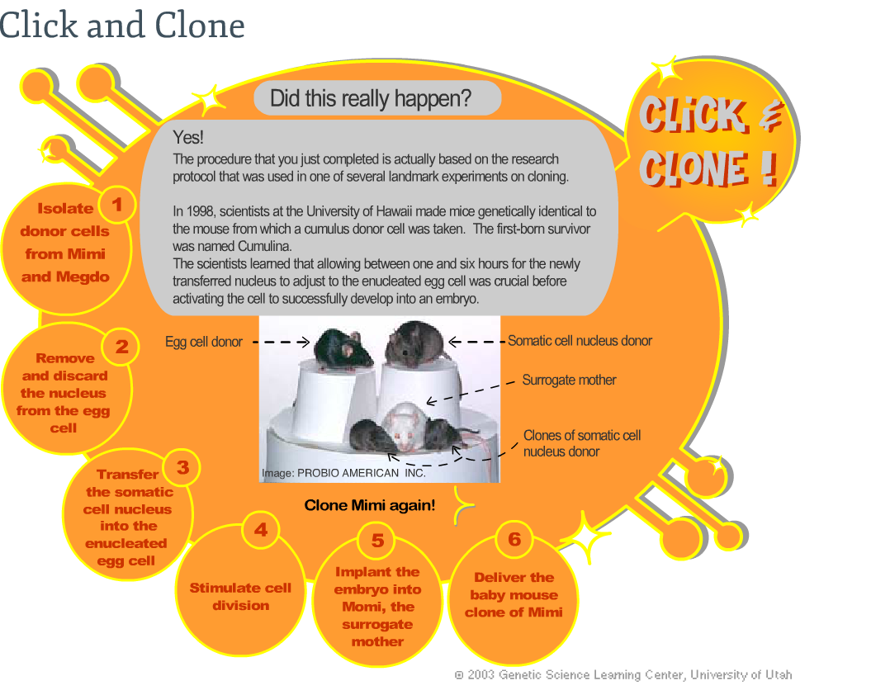
Clone a mouse – Virtual lab training for students
http://learn.genetics.utah.edu/content/cloning/clickandclone/
Virtual Labs
Cost effective
Enhance learning interest

Slide 14
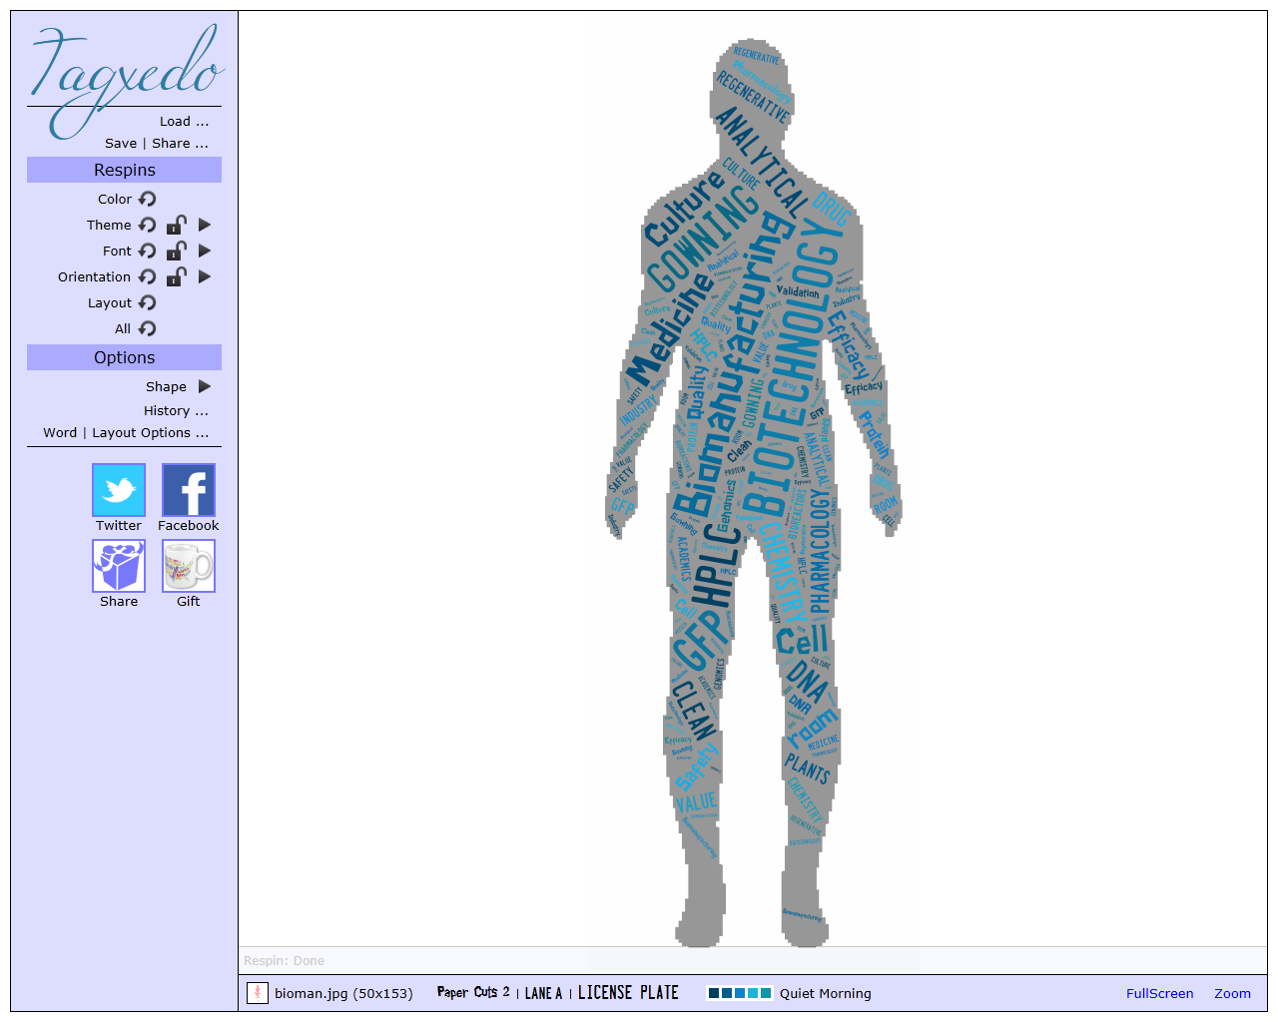
Summary
Biotech industry is growing at a rapid pace. There is a gap in the demand and supply of trained biotechnologists
Extensive and consistent outreach and awareness programs are required to bridge this gap
Track students interested in biotechnology and educate them on available resources, degree programs and jobs opportunities in this field.

Slide 15











Visits to Industries and Institutions

Slide 16
The BIFP Experience
The BIFP Fellowship has indeed enabled me to have a better insight into the amazing advancements that have been made, through the use of Biotechnology/Bioscience, in improving the quality of lives of people. The commitment and dedication of people from all strata of professional inclinations are very encouraging and a challenge to most of us. The future looks even brighter and more promising in what can be accomplished in this field - WFU Regenerative Medicine, David Murdock Res. Institute, Nanotechnology, other big and small biotech industries and their affiliates. The question that is before us is: “How do we all ensure that our future generations can competently improve on the breakthroughs of today in order to meet and sustain the challenges of tomorrow in this exciting field of biotechnology?" I intend to disseminate the experiences and information I have gained through this program to the Students, Faculty and Staff at this College and beyond.
Finally, a big THANK YOU to the Organizers of BIFP, the Sponsors, the Hosting Schools, Industries/Institutes. It was a wonderful experience indeed.

Slide 17
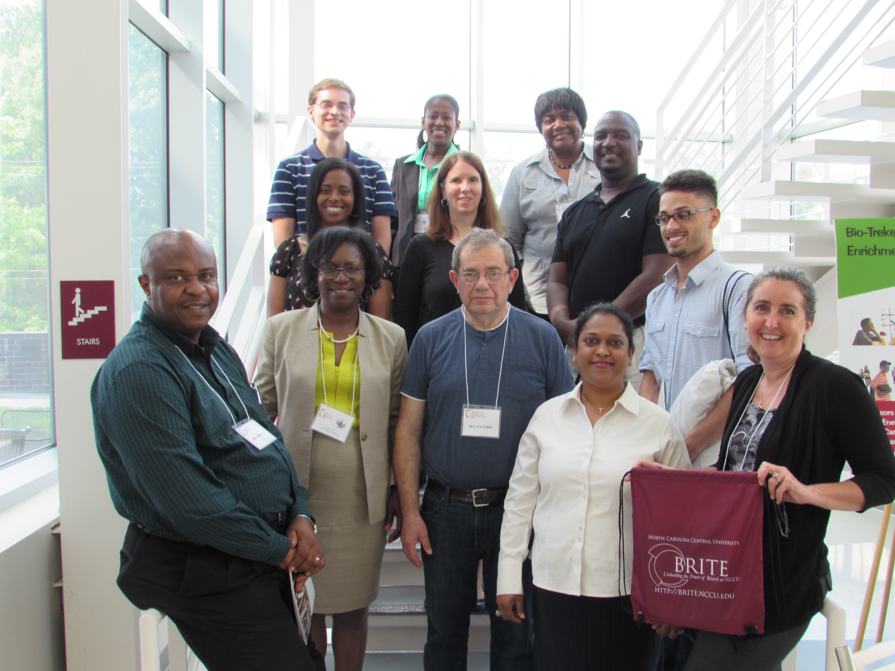

Slide 18
Thank you

Slide 19
BIOSCIENCES INDUSTRY FELLOWSHIP PROGRAM JUNE 2-27, 2014
Applications for
Developmental Math
Heather King
Developmental Math Instructor
Forsyth Technical Community College, NC
hking@forsythtech.edu

Slide 20


In every math class you will hear …
Why do I need to know this?
When will I ever use this?
In every science class you will hear …
Did I learn how to do this in my math class?

Slide 21
Basic Mathematical Concepts
Ratios
Proportions
Equations of Lines
Percents
Exponents
Biotechnology
Applications
Solving Equations
Basic Statistics
Fractions
Graphs
Formulas
Scientific Notation
Conversions

Slide 22
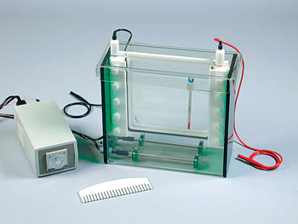
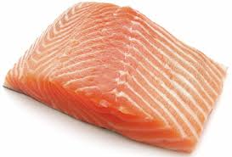

Expressions, Linear Equations & Inequalities
Dilutions of Solutions
Forsyth Technical Community College
Suppose you have a stock TGS electrophoresis buffer solution that is used in a protein profiler investigation of fish. The stock is 10 times more concentrated than the desired buffer. How would you prepare 400 mL at the correct concentration?
Concentration & Volume Formula
$$C_{1}V_{1}=C_{2}V_{2}$$

Slide 23

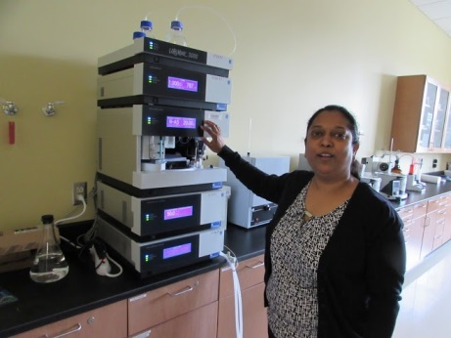
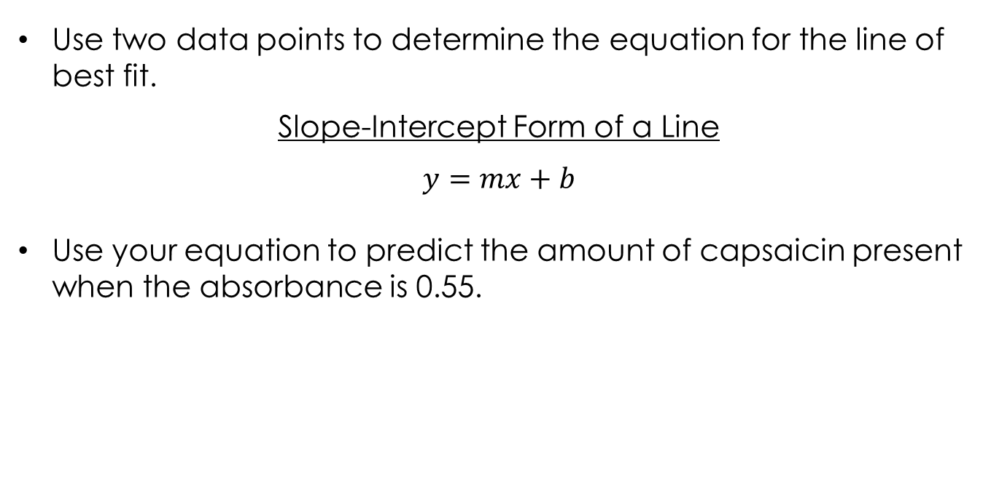
Linear Equations in Two Variables
Standard Curves & Unknown Concentrations
Rowan Cabarrus Community College
Use two data points to determine the equation for the line of best fit.
Slope-Intercept Form of a Line
$$y=mx+b$$
Use your equation to predict the amount of capsaicin present when the absorbance is 0.55.

Slide 24
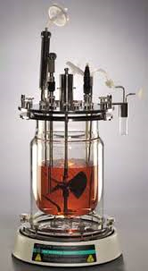
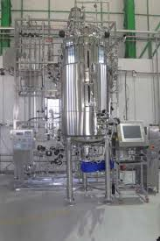
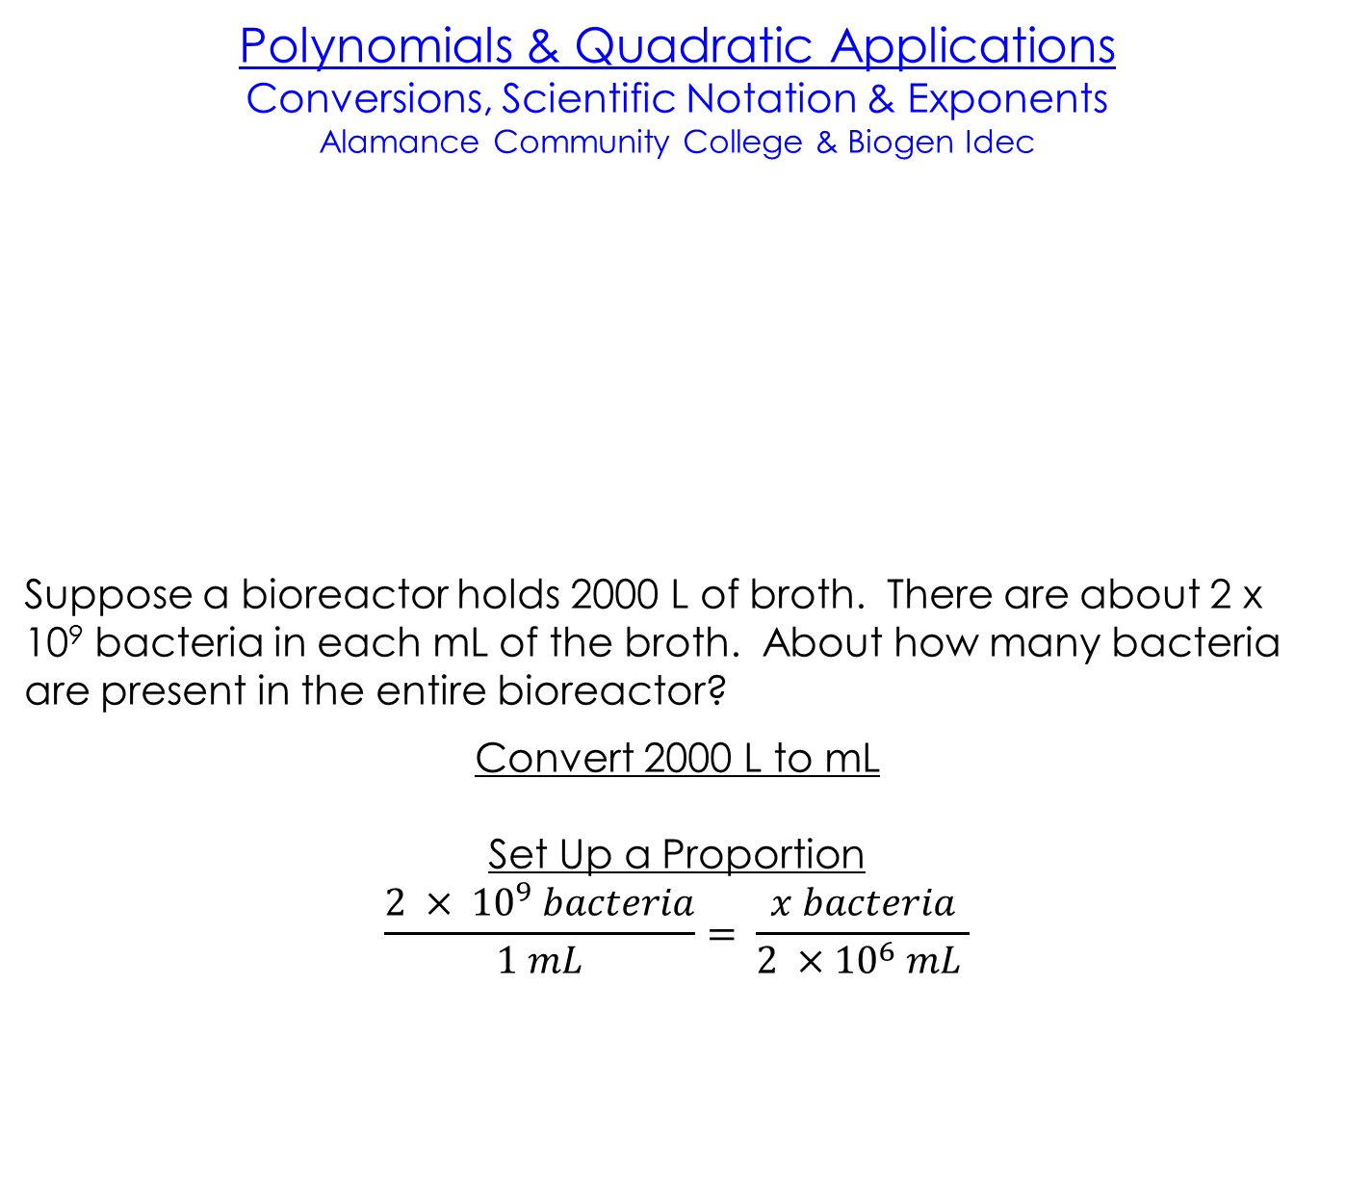
Polynomials & Quadratic Applications
Conversions, Scientific Notation & Exponents
Alamance Community College & Biogen Idec
Suppose a bioreactor holds 2000 L of broth. There are about 2 x 10⁹ bacteria in each mL of the broth. About how many bacteria are present in the entire bioreactor?
Convert 2000 L to mL
Set Up a Proportion
$$\frac{2 × {10}^{9} bacteria}{1 mL}= \frac{x bacteria}{2 ×{10}^{6} mL }$$

Slide 25
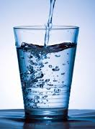
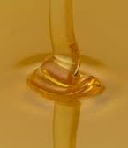

Rational Expressions & Equations
Stoke’s Law: Solid/Liquid Separation
BioNetwork Capstone Center
The settling velocity, $V_{g}$, is jointly proportional to the square of the diameter, D, and the difference in the densities of the solid, $ρ_{s}$, and the liquid, $ρ_{l}$, and inversely proportional to the viscosity, $μ$. For the constant of proportionality, use gravitational acceleration, $g$, divided by 18.
Choose the correct equation.
A. $V_{g}= \frac{D^{2}\left(ρ_{s}−ρ_{l}\right)}{μ} × \frac{g}{18}$ B.$V_{g}= \frac{μ}{D^{2}\left(ρ_{s}−ρ_{l}\right)} × \frac{g}{18}$
What happens to the settling velocity when the viscosity increases?
As the viscosity increases, the settling velocity decreases.

Slide 26
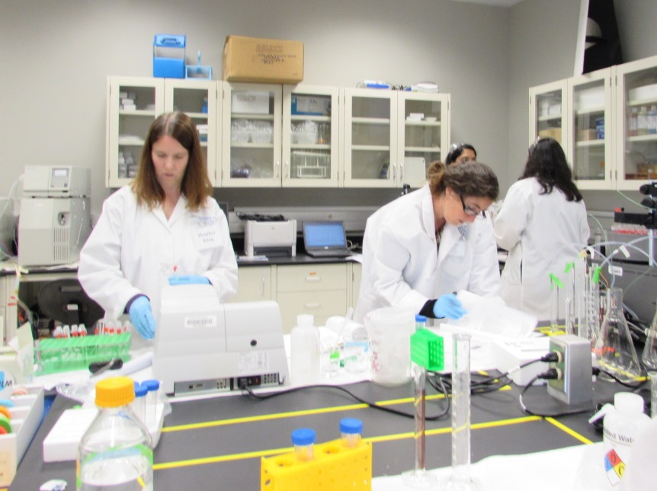
In every math class you will hear …
Do I have to show my work?
“If you didn’t document it, you didn’t do it.”

